Slide 1
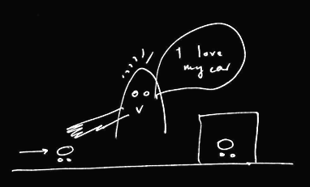
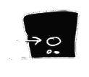
Rubio, Richardson & Butterfill
Notes:
First introduce them to a sequence in three slides ... [large pictures so hopefully everyone can see what’s going on]
These are all from the subject’s point of view.
We’re going to start with what looks almost exactly like the test condition from a standard false belief task.
(1) The observer watches as his car disappears behind a barrier on your [audience’s] left

Slide 2
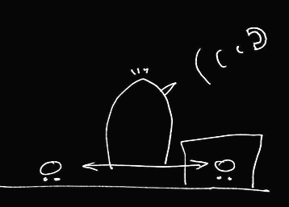

Rubio, Richardson & Butterfill
Notes:
(2) a telephone rings and the observer is distracted ... meanwhile the cars silently swap places (they’re electric cars, natch).

Slide 3
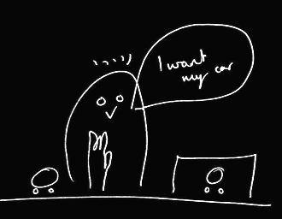
Rubio, Richardson & Butterfill
Notes:
(3) the observer comes back and wants to get her car (note the raised hand). Where do subjects look? They know that the observer’s car is actually behind the barrier. They are also in a position to know that the observer might not know this and might mistakenly think that his car is the one on subject’s LEFT.

Slide 4

Rubio, Richardson & Butterfill
Notes:
(3) the observer comes back and wants to get her car (note the raised hand). Where do subjects look? They know that the observer’s car is actually behind the barrier. They are also in a position to know that the observer might not know this and might mistakenly think that his car is the one on subject’s LEFT.

Slide 5

Rubio, Richardson & Butterfill
Notes:
(3) the observer comes back and wants to get her car (note the raised hand). Where do subjects look? They know that the observer’s car is actually behind the barrier. They are also in a position to know that the observer might not know this and might mistakenly think that his car is the one on subject’s LEFT.

Slide 6

Rubio, Richardson & Butterfill
Notes:
(3) the observer comes back and wants to get her car (note the raised hand). Where do subjects look? They know that the observer’s car is actually behind the barrier. They are also in a position to know that the observer might not know this and might mistakenly think that his car is the one on subject’s LEFT.

Slide 7

Rubio, Richardson & Butterfill
Notes:
(3) the observer comes back and wants to get her car (note the raised hand). Where do subjects look? They know that the observer’s car is actually behind the barrier. They are also in a position to know that the observer might not know this and might mistakenly think that his car is the one on subject’s LEFT.

Slide 8
Rubio, Richardson & Butterfill
Notes:
Here’s the whole sequence again, smaller.
If we were doing a standard false belief test, we could compare where people look in this sequence with where they look in another sequence in which the observer doesn’t turn away in the second scene.
If subjects can track false beliefs, we would expect them to be more likely to look towards SUBEJECTS-LEFT location in the depicted narrative than in the control version where the subject is not distracted by the telephone and so does not look away.
So this is almost a standard false belief task.
And like all standard false belief tasks, it requires tracking false beliefs about location only; it doesn’t require tracking false beliefs about registration.
Now consider a tiny variation ...

Slide 9
Rubio, Richardson & Butterfill
Notes:
... the middle vertical sequence is just like the right vertical sequence except that one of the barriers has been removed.
Now there are two ways of thinking about this.
On one way of thinking about it, there is no reason to think that the observer has a false belief because in the final scene (of the middle sequence) he’s looking right at a car which is not his own.
But if you think about this more carefully, that isn’t quite right because the car he’s looking at, although not his own, is visually indistinguishable from his own. So he might well believe, falsely, that his car on SUBJECTS-LEFT is actually his car.
So where subjects are capable of tracking false beliefs involving identity & where they realize that the cars are visually indistinguishable, they should be able to predict an incorrect reach.
But if subjects are not tracking about false beliefs about identity, then they will think that the observer will be able to retrieve his car from its actual location.

Slide 10
2
3
Rubio, Richardson & Butterfill
Notes:
... so let’s illustrate this with some graphs ...

Slide 11

2
3
belief: 2 ≈ 3
Rubio, Richardson & Butterfill
Notes:
... so let’s illustrate this with some graphs ...

Slide 12


2
3
belief: 2 ≈ 3
Rubio, Richardson & Butterfill
Notes:
... so let’s illustrate this with some graphs ...

Slide 13
2
3
left
right
left
right
belief: 2 ≈ 3
2
3
Rubio, Richardson & Butterfill
Notes:
... so let’s illustrate this with some graphs ...

Slide 14


2
3
left
right
left
right
belief: 2 ≈ 3
2
3
registration: 2 ≈ 3
Rubio, Richardson & Butterfill
Notes:
... so let’s illustrate this with some graphs ...

Slide 15

2
3
left
right
left
right
belief: 2 ≈ 3
2
3
registration: 2 ≈ 3
Rubio, Richardson & Butterfill
Notes:
... so let’s illustrate this with some graphs ...

Slide 16
2
3
left
right
left
right
belief: 2 ≈ 3
2
3
registration: 2 ≈ 3
left
right
left
right
2
3
Rubio, Richardson & Butterfill
Notes:
... so let’s illustrate this with some graphs ...

Slide 17
2
3
left
right
left
right
belief: 2 ≈ 3
2
3
registration: 2 ≈ 3
left
right
left
right
2
3
Rubio, Richardson & Butterfill
Notes:
... so let’s illustrate this with some graphs ...

Slide 18
Rubio, Richardson & Butterfill
Notes:
now consider a third variation ...

Slide 19

Rubio, Richardson & Butterfill
Notes:
The new sequence is the one on your [the audience’s] left.
Here the two cars are visibly distinguishable.
To us it probably seems obvious that, in the left vertical sequence, the observer will reach behind the barrier. Whereas this is not nearly so obvious in the middle vertical sequence. But now consider someone incapable of reasoning about false beliefs involving identity. From her point of view, the two sequences are not different. To her what matters is just that numerically distinct objects appear on the left. So (assuming she doesn’t lose track of the objects) she has no more reason to think that the observer will reach behind the barrier in the middle sequence than she does in the left sequence.

Slide 20
1
2
3
Rubio, Richardson & Butterfill
Notes:
... lets illustrate this with some graphs

Slide 21




1
2
3
belief: 2 ≈ 3
registration: 2 ≈ 3
belief: 1 ≈ 2
registration: 1 ≈ 2
Rubio, Richardson & Butterfill
Notes:
... lets illustrate this with some graphs

